Slide 1


Inclusive education: supporting LGBT Young People
25 January 2020
Notes:
2 min – Thank everyone for attending today’s workshop.

Slide 2

Cat Telford
Pronouns: They/Them
Empowerment Programmes Officer
Notes:
2 min - Introduce self.

Slide 3



WHO STONEWALL SCOTLAND ARE
Notes:
4 min – introduce Stonewall to folks who may not know us that well and how our work with education practitioners fits into these priorities.

Slide 4

Introductions
Name
Pronoun
Whereabouts you work
Notes:
7 min, for folks to introduce themselves.

Slide 5
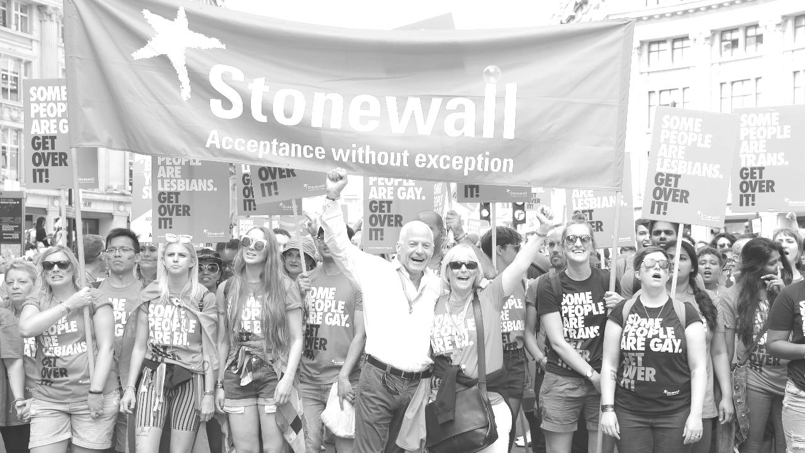
1. Definitions – resources for teaching staff
Notes:
1 min

Slide 6

In groups match the definitions to their terms.
Don’t worry if you can’t do all of them, or if you’re not sure on some.
You’ve got 7 minutes to do as many as you can.
We’ll go through the answers once everyone’s had a go.
Notes:
14 mins for this slide.
7 mins to work through their answers.
7 mins to go through the answers.

Slide 7
2. Policy resources
Notes:
1 min

Slide 8



Our Policy guides are designed to:
Help you develop your own evidence-base for approaching this work;
Help you communicate your inclusion journey to key stakeholders;
Assist with looking at current policies and what can be adapted.
Notes:
4 min

Slide 9
3. Resources for Building an inclusive culture
Notes:
1 min

Slide 10


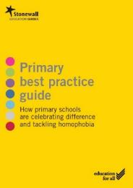
These guides offer more practical advice and guidance on supporting LGBT young people and how staff in your setting can create a more inclusive culture.
Notes:
1 min

Slide 11
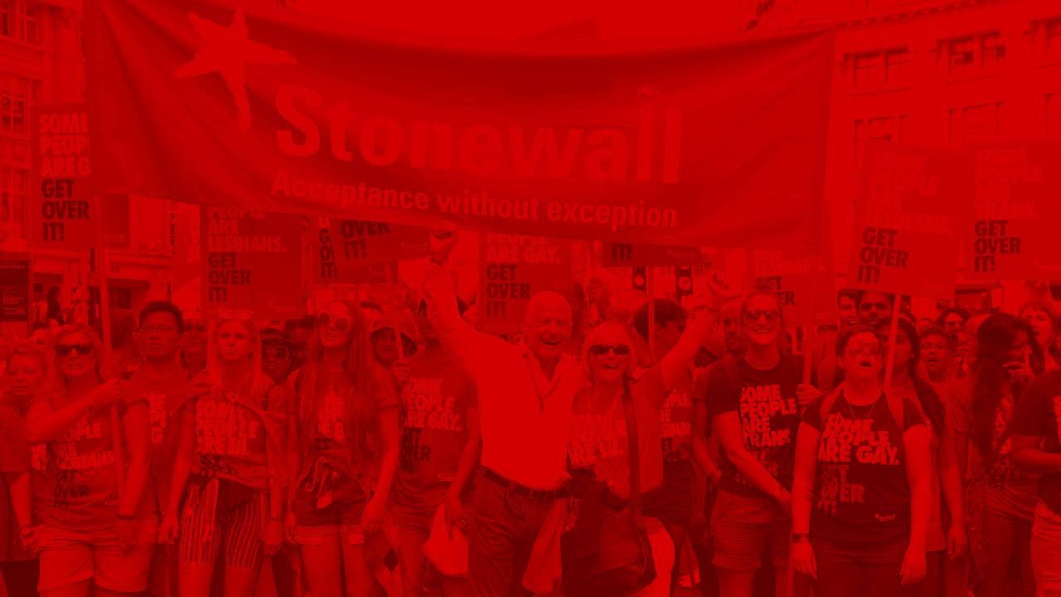

Example: Supporting LGBT Young People
Covers topics such as:
How to talk to young people about the meaning of
different terms, in an age appropriate way.
What practitioners can look out for and help them
recognise HBT bullying.
What support for a young LGBT person might look
like.
Notes:
3 min

Slide 12
3. Inclusive materials
Notes:
1 min

Slide 13
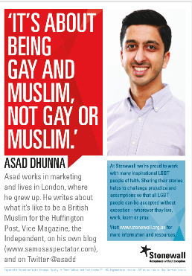

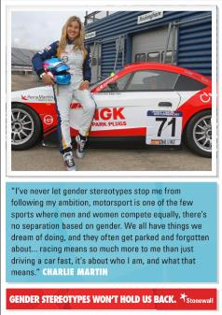
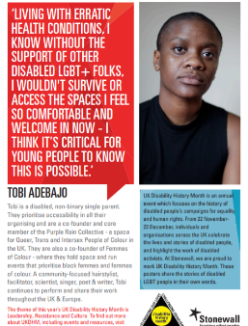
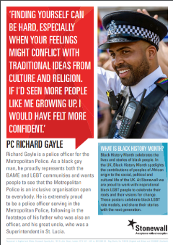
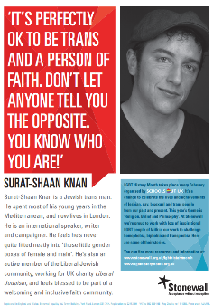
Posters
Notes:
4 min

Slide 14
Stonewall and BAME voices - https://www.youtube.com/playlist?list=PL663Gvd8xcPpbj4KYsP8oEZjqpXLc14JD
Stonewall and MyGenderation – sharing trans voices - https://www.youtube.com/playlist?list=PL663Gvd8xcPoXdzDEeyQyqeeoHI6G7QEr
We also do Campaigns videos, for Rainbow Laces, Come Out for LGBT and our Supporter appeals – where we share individual’s stories:
Rainbow Laces - https://youtu.be/oLg-27Mi0qk
Come Out for LGBT – https://youtu.be/V1oqK43CED4
Jak’s story - https://youtu.be/-9V73GQ_5ZU
Videos
Notes:
6 mins

Slide 15
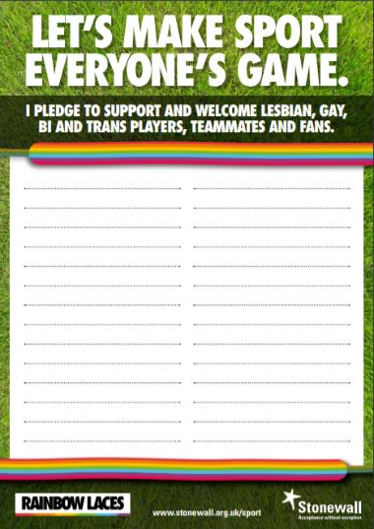
Rainbow Laces
Notes:
3 mins

Slide 16

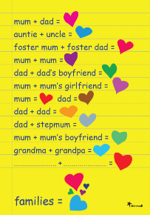

LGBT Booklists for Primary ages and Secondary ages.
Visibility in the wider world
Inclusive families resources – including posters and stickers.
LGBT Filmlists for Secondary ages.
Notes:
1 min

Slide 17

Top Tips for developing inclusive cultures and lesson materials
Don’t make assumptions.
Think about the representation you have in your classroom – posters, displays etc.
Think about the representation you have in the examples you use and the questions you ask and how LGBT can be visible in your area.
Think about whose voices you could be amplifying more.
Stand up to bullying in a visible way.
Notes:
3 min

Slide 18
Any questions?
Notes:
2min

Slide 19

Thanks for
attending
today’s
session!
Cat.Telford@stonewallscotland.org.uk
Notes:
End

